Slide 1
Task 3 vulnerability report
Reported by – Asawari More.

Slide 2
Index
Basic Information
Vulnerability Details
Steps to reproduce
Impact
Action to take
Remedy
Video and Screenshot

Slide 3
Basic Information
Vulnerability Name – Boolean based SQL Injection
URL : http://testasp.vulnweb.com/Login.asp?RetURL=/Default.asp?
Attack pattern : admin' or '1’=‘1
Environment : windows 10
Identified Database Name : asuforum
Identified Database version : microsoft sql server 2014 (sp3-gdr) (kb4583463) - 12.0.6164.21 (x64) nov 1 2020 04 25 14 copyright (c) microsoft corporation express edition (64-bit) on windows nt 6.3 <x64> (build 9600 ) (hypervisor)

Slide 4
Steps to reproduce
Visit the website : http://testasp.vulnweb.com/
Open the login section.
Enter username as : asuforum
Enter Password = admin' or '1'=‘1
Login using above credential.
You will get successful logged and will be get redirected to next page.
By using Boolean based sql injection attacker can easily retrieve your information from databases.

Slide 5
Vulnerability Details
I identified a Boolean-based SQL injection, which occurs when data input by a user is interpreted as a SQL command rather than as normal data by the backend database.
Boolean-based SQL injection is a technique which relies on sending an SQL query to the database. This injection technique forces the application to return a different result, depending on the query. Depending on the Boolean result (TRUE or FALSE)
Even though it is a slow attack this will help the hacker to enumerate the database.
This is an extremely common vulnerability and its successful exploitation can have critical implications.
It has been confirmed that the vulnerability by executing a test SQL query on the backend database.
In these tests, SQL injection was not obvious, but the different responses from the page based on the injection test allowed us to identify and confirm the SQL injection.

Slide 6
Impact
Depending on the backend database, the database connection settings and the operating system,
an attacker can mount one or more of the following type of attacks successfully:
Reading, updating and deleting arbitrary data/tables from the database
Executing commands on the underlying operating system
Gain full access to the database server.
Gain a reverse shell to the database server and execute commands on the underlying operating system.
Access the database with full permissions, where it may be possible to read, update or delete arbitrary data from the database.
Depending on the platform and the database system user, an attacker might carry
out a privilege escalation attack to gain administrator access to the target system.

Slide 7
Action to Take
If you are not using a database access layer (DAL), consider using one. This will help you centralize the issue. You can also use ORM (object relational mapping). Most of the ORM systems use only parameterized queries and this can solve the whole SQL injection problem.
Locate all of the dynamically generated SQL queries and convert them to parameterized queries. (If you decide to use a DAL/ORM, change all legacy code to use these new libraries.)
Use your weblogs and application logs to see if there were any previous but undetected attacks to this resource.

Slide 8
Remedy
The best way to protect your code against SQL injections is using parameterized queries (prepared statements). Almost all modern languages provide built-in libraries for this. Wherever possible, do not create dynamic SQL queries or SQL queries with string concatenation.
Create a database user with the least possible permissions for your application and connect to the database with that user. Always follow the principle of providing the least privileges for all users and applications.
Primary Defences:
Use of prepared statements(With parameterised Queries)
Use of stored Procedures
White list input validation.
Escaping all users supplied input
Enforcing list privilege
Performing white list input validation as a secondary defense.

Slide 9
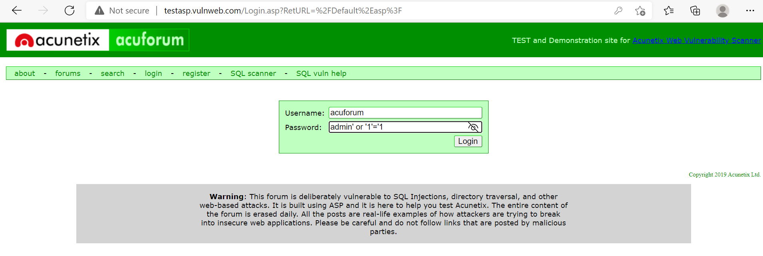
Screenshot

Slide 10
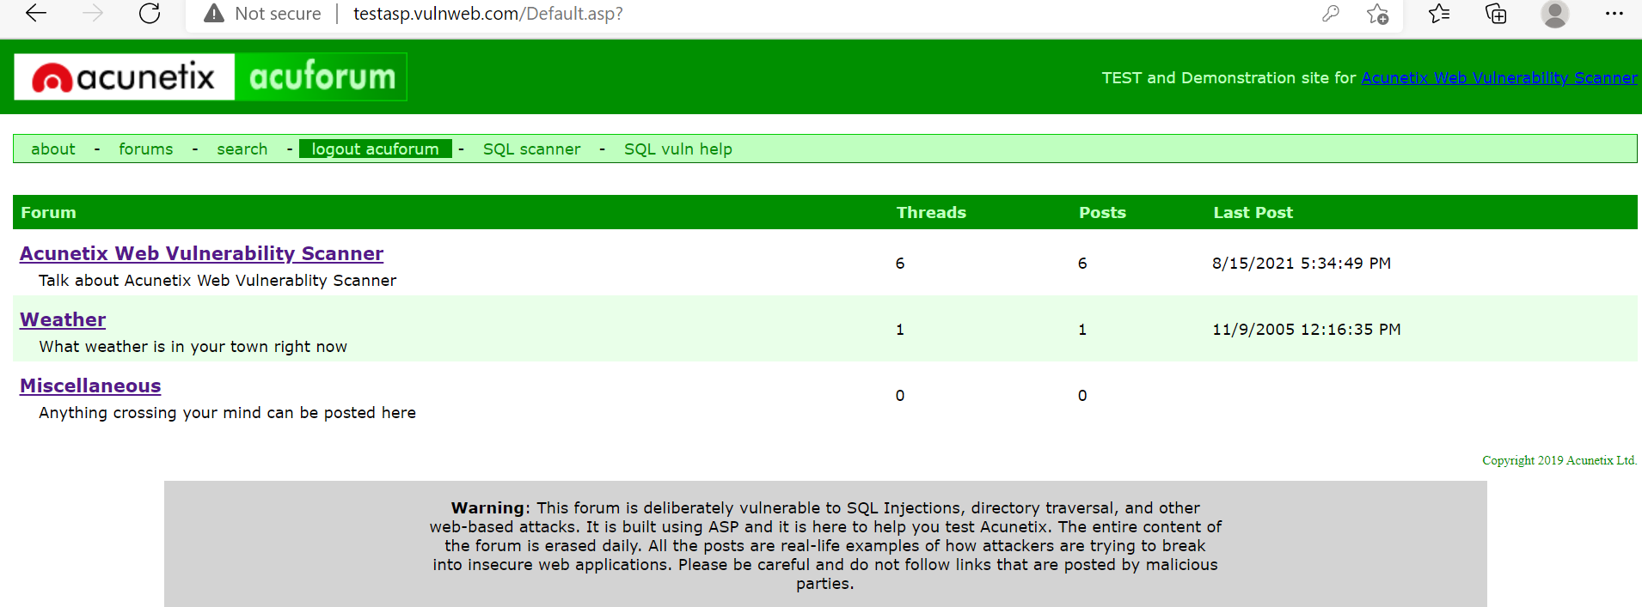
Successfully logged in screenshot

Slide 11
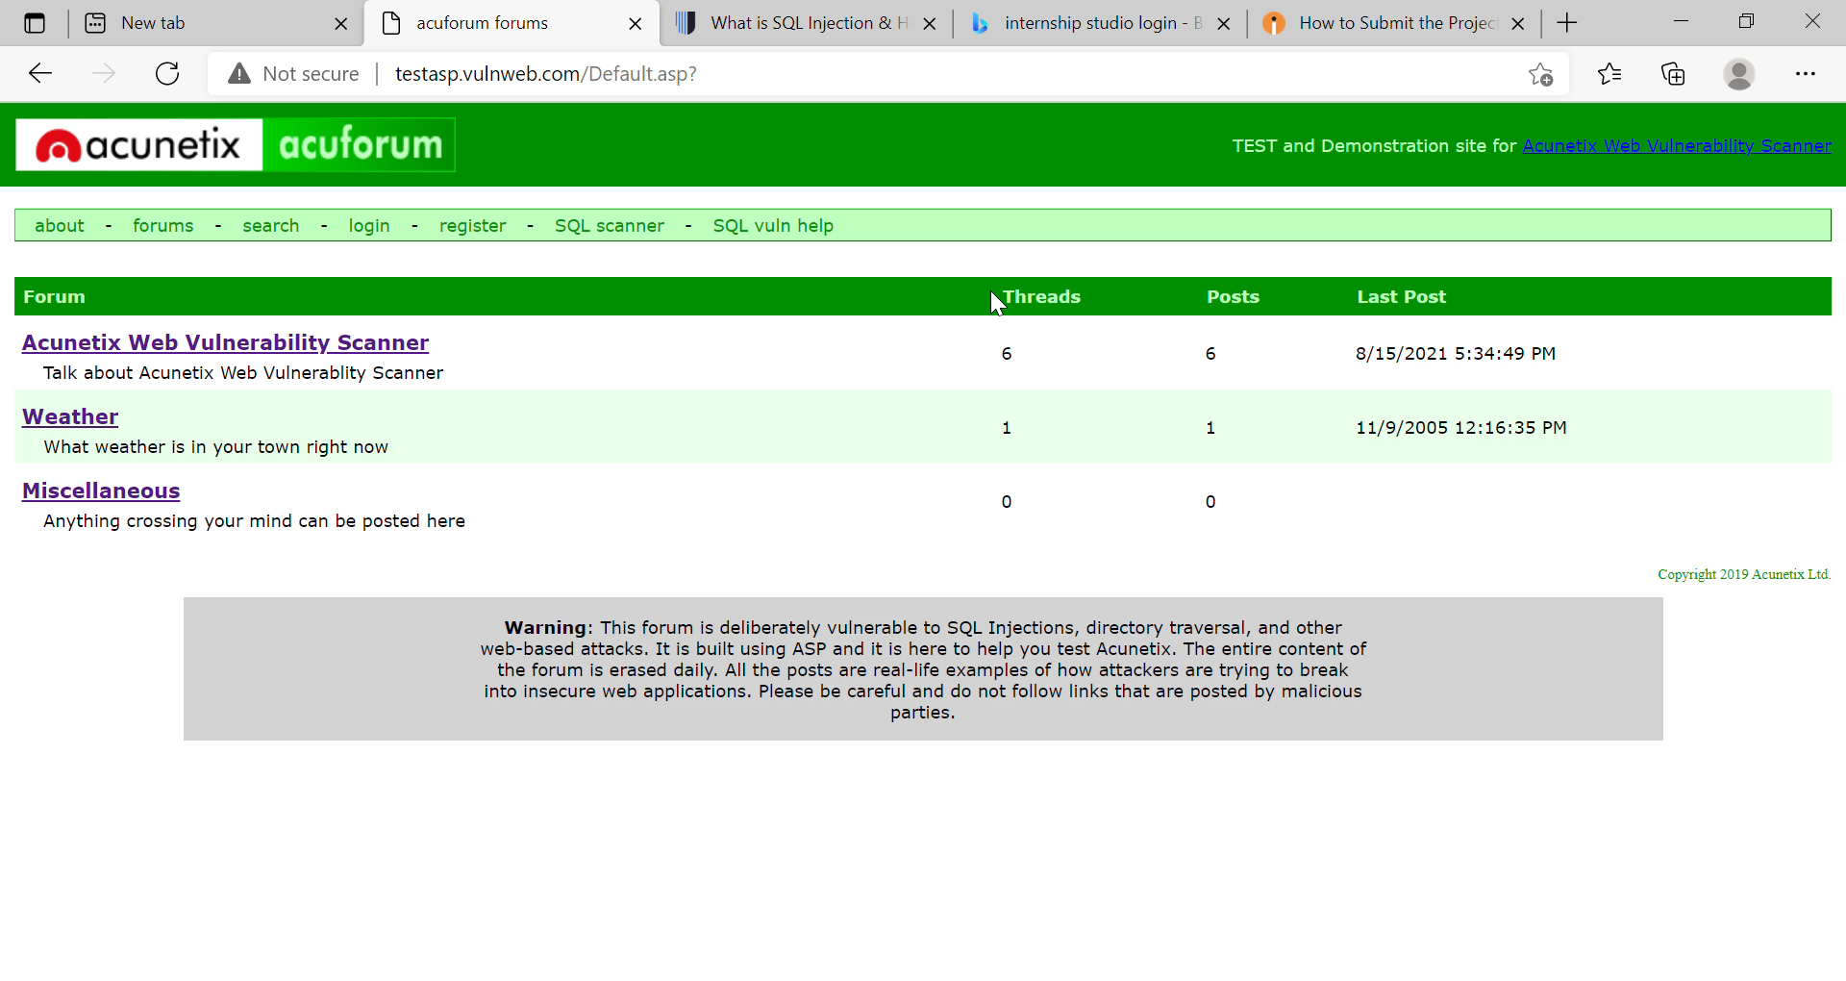
video

Slide 12
Thank you!!!!

